Slide 1
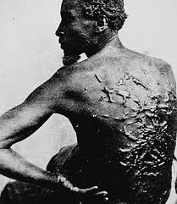
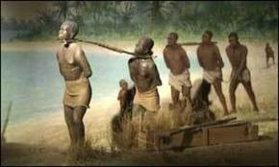
Slavery begins!
According to the PBS.org web site, Africans were first brought to America in 1619. In that year 20 African people were brought to the Jamestown colony aboard a Dutch warship. They were slaves, they were taken from their homes in Africa by force. They were beaten and enchained. they were used to grow tobacco crops, pick cotton and other chores that white men didn’t want to do in Jamestown Virginia (“pbs.org”).
Notes:
5 paragraphs
Who what where when why then conclusion

Slide 2
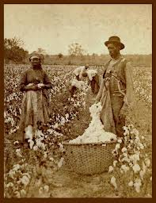
Picking cotton
Slaves were forced to do a lot of work in early America, Everything from gathering cotton to harvesting tobacco. Slaves had no say in what task they were required to do and no control over the length of their working day which was usually from sunup in the morning to sunset in the evening. slaves were used in the northern states in factories to produce manufactured goods, most slaves worked on plantations in the southern states. It was usually young girls that churned milk into butter.
Notes:
Black Peoples of America. Updated 08/10/2012. text. History on the net .comWeb. 31 Jan 2013. <http://historyonthenet.com/Slave_Trade/work.htm>.

Slide 3
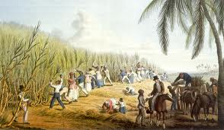
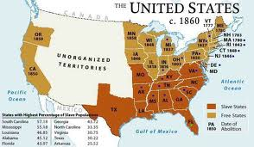
http://en.wikipedia.org/wiki/Slavery_in_the_United_States
Most black people were captured and sold to “slavers” (people who buy/trade slaves) by other cultures. The slavers then transported them to places where there was a market for cheap labor. Tobacco became the main resource in the colony. Once it became clear that tobacco was going to drive the Jamestown colony, more labor was needed. The British aristocracy needed to find a labor force to work on its plantations in the Americas.
About 600,000 slaves were imported into the U.S. The great majority of African slaves went to sugar colonies in the Caribbean and to Brazil, where life expectancy was short and the numbers had to be continually replenished. Life expectancy was much higher in the U.S. (because of generally better food, less disease and better medical care)

Slide 4
http://www.youtube.com/watch?v=YYpwYWta4eo

Slide 5
The end!!

